Slide 1




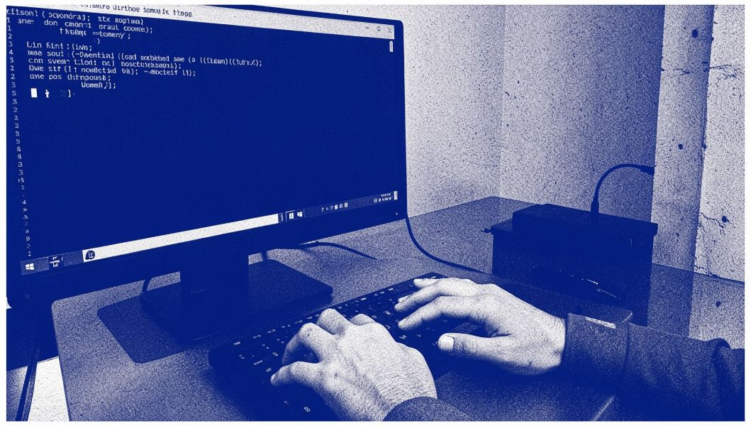
OPERATING SYSTEMS · C PROGRAMMING AND LINUX
COPY-ON-WRITE
MEMORY
DEMONSTRATOR
COPY-ON-WRITE MEMORY DEMONSTRATOR
PARENT PROCESS
SEPARATE VALUES
original memory owner
CHILD PROCESS
copy on write trigger
forked duplicate
,
TEAM MEMBER
TEAM MEMBER
TEAM MEMBER
2520090081 — SAI RAM PRAGNEY MURIKIPUDI
2520090194 — NAMAN MASINENI
2520090131 — RISHI PRADYUMAN VADLAMUDI
Notes:
Introduce the project as a student demonstration in Operating Systems, C Programming and Linux. The goal is to show how parent and child processes keep separate values when one process modifies memory.

Slide 2

THE RESOURCE PROBLEM
PROCESS CREATION / MEMORY MANAGEMENT
COPYING ALL MEMORY CAN WASTE RESOURCES
CREATE PROCESS
IMMEDIATE COPY
Creating processes requires memory management.
COPY-ON-WRITE
Copying every memory page immediately may use unnecessary resources.
Copy-on-Write delays copying until a process needs to write.
Our demonstrator uses a parent and child process to show the behavior.
Notes:
Explain the motivation. Creating processes requires memory management. Copying every memory page immediately may use unnecessary resources, so Copy-on-Write delays copying until a process needs to write.

Slide 3
PROGRAM WORKFLOW / FIVE STEPS
THE PROGRAM FOLLOWS ONE CLEAR WORKFLOW
Allocate
Store
Create
Modify
Read
mmap() creates shared virtual memory
write the initial value 100
fork() creates the child process
the child changes its value to 200
the parent still reads 100
WAIT
RELEASE
waitpid() makes parent wait for child
munmap() releases allocated memory
Notes:
Walk through the program in order. mmap() allocates the shared virtual memory, the initial value is 100, fork() creates the child, the child changes its value to 200, and the parent still reads 100. waitpid() and munmap() complete the workflow.

Slide 4
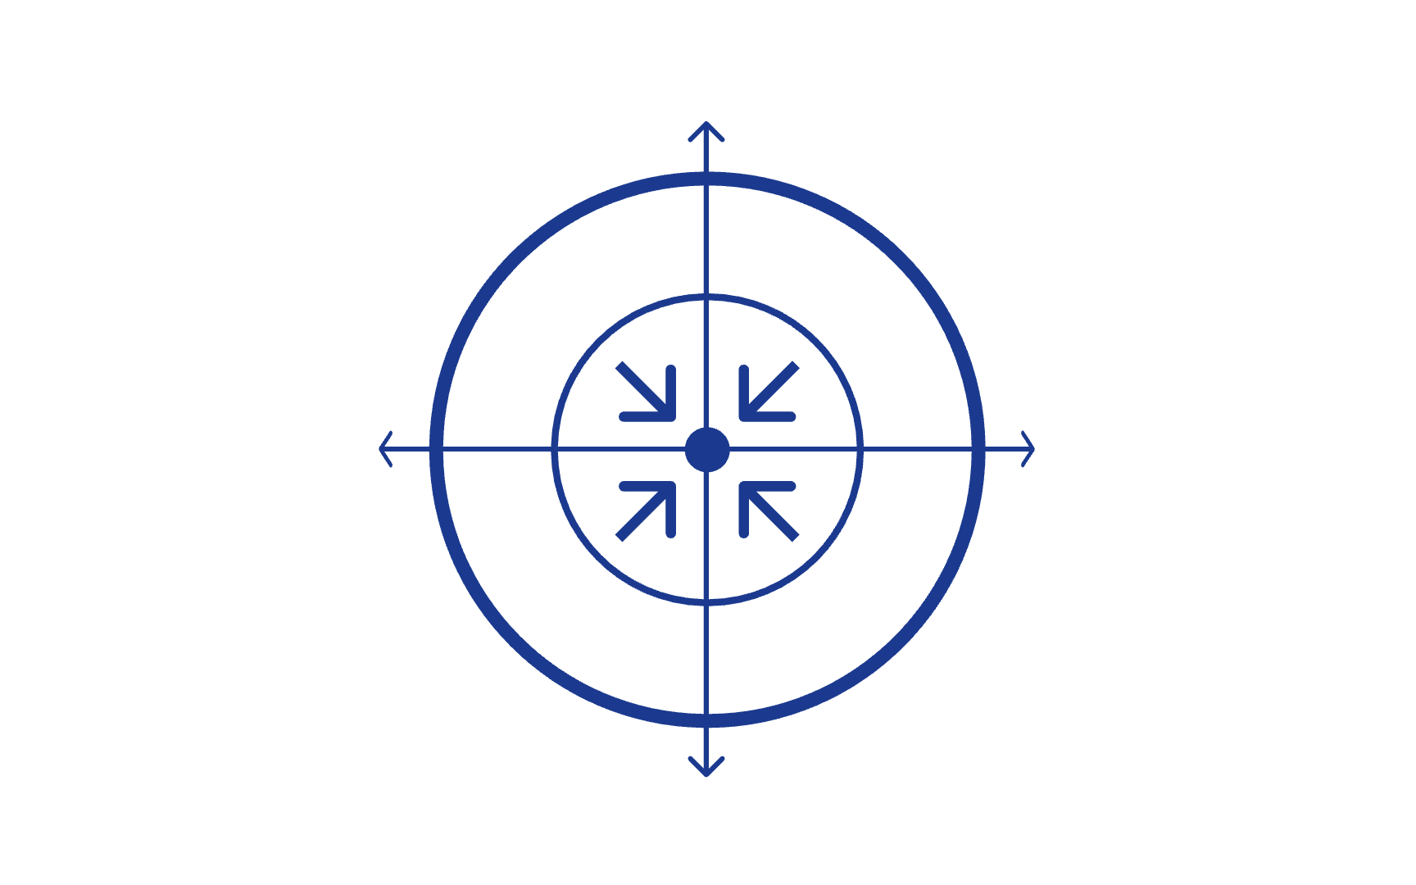
MEMORY ISOLATION / PROCESS BEHAVIOR
SEPARATE VALUES
COPY-ON-WRITE PROTECTS PROCESS MEMORY
100
→
200
Pages can be shared initially and copied when a write requires it.
PROCESS
MEMORY ISOLATION
VIRTUAL MEMORY
Parent keeps 100; child changes its value to 200.
COPY-ON-WRITE
Notes:
Define the terms simply. A process is a program in execution. Virtual memory gives each process its own virtual address space. Copy-on-Write lets pages be shared initially, while a private write creates separation. The parent keeps 100 and the child changes its value to 200.

Slide 5
COMPILED AND RUN SUCCESSFULLY · EXPECTED OUTPUT
THE EXPECTED OUTPUT
CONFIRMS SEPARATE VALUES
OUTPUT LINE | VALUE
Initial value | 100
Child before write | 100
Child after write | 200
Parent after child write | 100
The child changes its value, but the parent still reads 100. This demonstrates separate memory behavior.
COMPILE
gcc -Wall -Wextra cow_demo.c -o cow_demo
RUN
./cow_demo
Notes:
Use the output to confirm the behavior. Both processes begin with 100. After the child writes 200, the child reads 200 but the parent still reads 100. The program was compiled and run successfully with the shown commands.

Slide 6
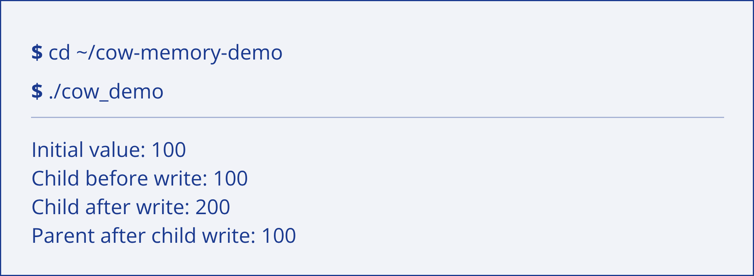
REPRODUCTION / LIVE DEMONSTRATION
THE DEMONSTRATION IS SIMPLE TO REPRODUCE
README contains project details and setup instructions
Source code is written in C
Run it on Ubuntu/Linux or Ubuntu on WSL2
Live demonstration: show the parent and child values
TERMINAL-STYLE ILLUSTRATION ONLY · NO FABRICATED SCREENSHOT
Notes:
Show how to reproduce the demonstration. The README contains project details and setup instructions, the source code is written in C, and it can run on Ubuntu/Linux or Ubuntu on WSL2. Use the terminal-style illustration to show the live commands and values, not a fabricated screenshot.

Slide 7
CONCLUSION / FUTURE SCOPE
Demonstrates parent–child process behavior
Explains process creation, Copy-on-Write, and memory isolation
Helps students understand Linux memory management
Current program demonstrates values, not physical page frames or performance measurements
Future scope: interactive input, memory-usage measurements, and tools to inspect page behavior
COPY-ON-WRITE MAKES MEMORY BEHAVIOR VISIBLE
Thank You
Notes:
Close by emphasizing what the demonstrator makes visible: parent–child process behavior, process creation, Copy-on-Write, and memory isolation. Be clear about the current scope: it demonstrates values, not physical page frames or performance measurements. Future scope includes interactive input, memory-usage measurements, and tools to inspect page behavior.

